Slide 1
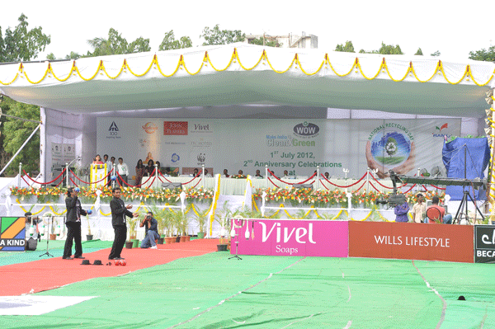
Inside ITC’s first CSR event, National Recycling Day (July 2012)
ITC Company Branding
Tobacco Branding

Slide 2
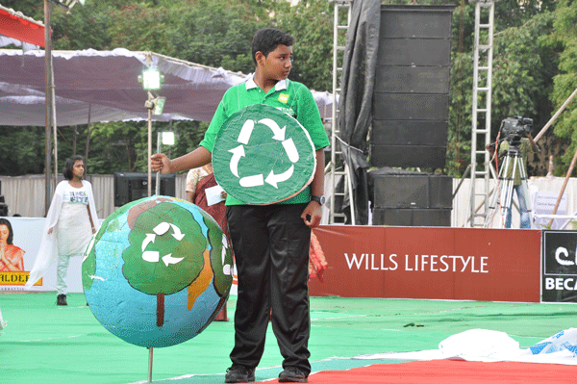
One of the 10,000 school children at ITC’s National Recycling Day
Tobacco Branding

Slide 3
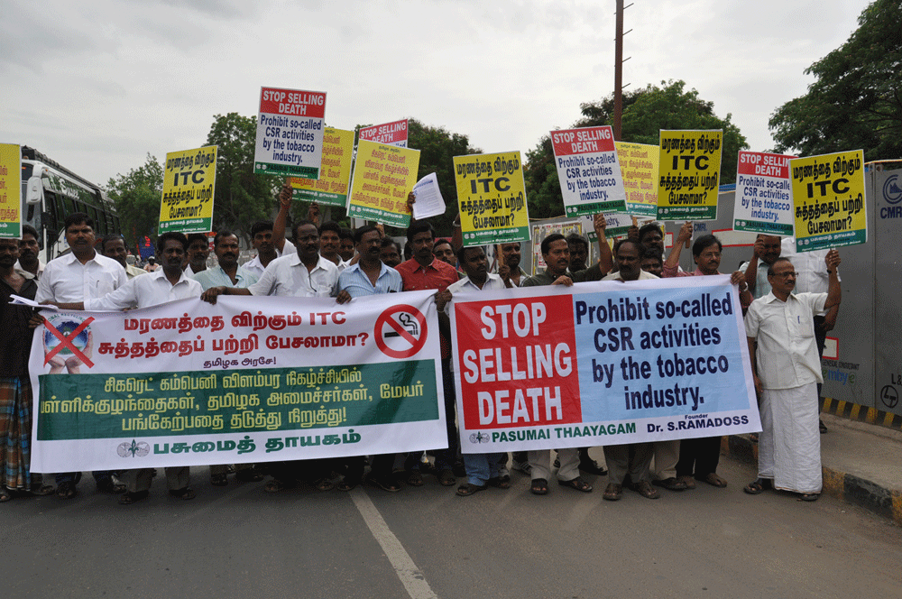
Protest outside of ITC’s CSR event

Slide 4
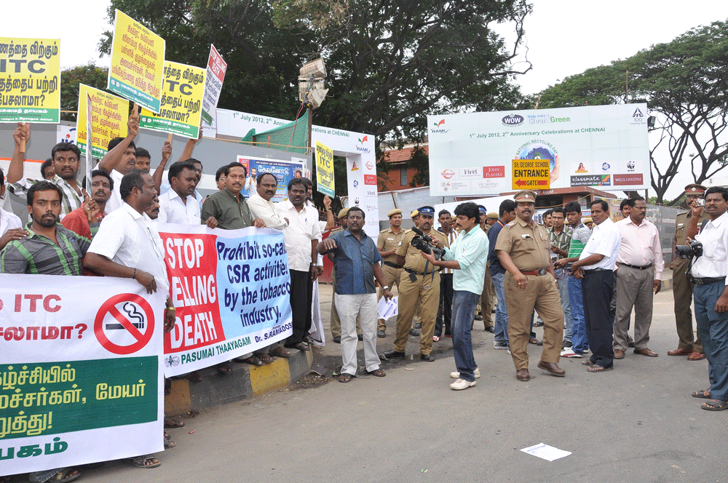
Protest outside of ITC’s event

Slide 5
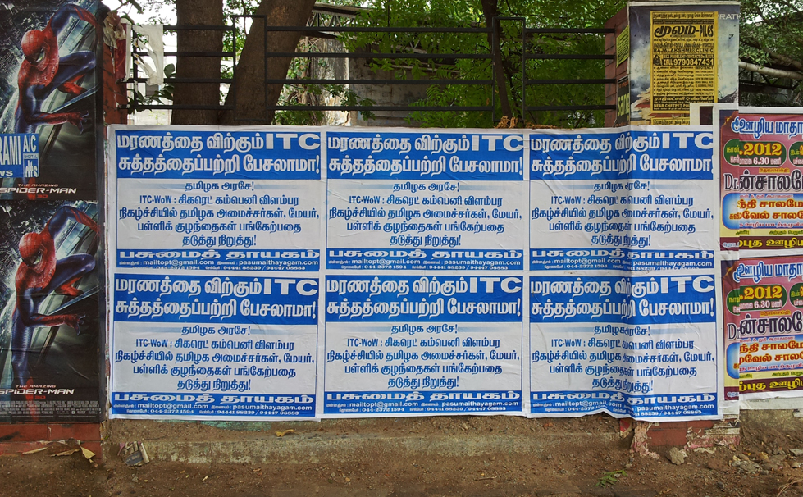
Wall poster against ITC’s CSR event

